Slide 1



CHURN SPRINT ANALYTICS:
Sprinting Towards Customer Retention Excellence with Data Analytics and Machine Learning
We Have Team

Slide 2

Table of
CONTENTS
01
02
03
04
Title
Team Introduction
Introduction
Data & Methodology
05
06
Result
Conclusion

Slide 3



Meet
THE TEAM
Harry Maringan Tua
Vety Bhakti Lestari
Team Lead
Bachelor of Statistics
Data Scientist
Team Member
Bachelor of Statistics
Data Scientist

Slide 4

INTRODUCTION
Customer attrition is a significant issue and a top worry for big businesses, particularly those in the telecom industry. The percentage of consumers that discontinue their service subscription is known as the churn rate, or churn. A prevalent issue for companies in many sectors, such as banking, journalism, insurance, and telecommunications, is customer turnover. In the telecom sector, low switching barriers and customer service are the main causes of customer churn. The churn measure is often displayed as the proportion of consumers that discontinue a service or product within a certain time frame. Identifying the causes of client attrition and taking the appropriate steps to lower it is critical.

Slide 5

Problem
In the very competitive telecom sector, maintaining a customer base is essential to long-term economic viability. The practice of customers switching service providers, or "churn," presents a big problem for telecom firms. It's crucial to develop proactive retention strategies that not only identify why customers leave but also anticipate potential churn, thereby enhancing efforts to retain and gain customer loyalty.
STATEMENT

Slide 6
Customer Profiling
Goals and
Understanding customer behavior is integral to predicting churn. Analyzing usage patterns, service interactions, and demographic data allows for the creation of comprehensive customer profiles, enabling tailored strategies to retain customers
OBJECTIVES
Churn Deep Dive Analysis
A comprehensive analysis of churn involves delving deep into customer data. Investigating the reasons behind churn, identifying pivotal factors contributing to customer attrition, and examining the timing and context of churn events provide critical insights for retention strategies.
Build Churn Prediction App
Developing a predictive application capable of foreseeing potential churn is essential. Leveraging machine learning models and historical customer data, the app aims to forecast churn, empowering telecom companies to take proactive measures to retain customers before they consider switching to other providers.

Slide 7
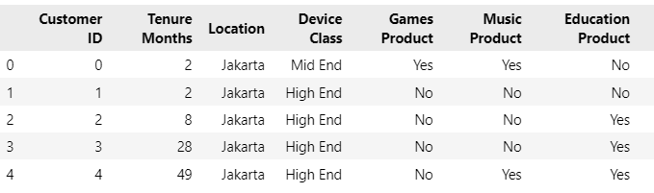



Data & Methodology
Data
Steps
Problem Definition
Model Development
Model Deployment
Data Understanding & EDA
Feature Engineering
data.head() [images by author]
Dataset containing 16 column:
Customer ID (A unique customer identifier)
Tenure Months (How long the customer has been with the company by the end of the quarter specified above)
Location (Customer’s residence - City)
Device Class (Device classification)
Games Product (Whether the customer uses the internet service for games product)
Music Product (Whether the customer uses the internet service for music product)
Education Product (Whether the customer uses the internet service for education product)
Call Center (Whether the customer uses the call center service)
Video Product (Whether the customer uses video product service)
Use MyApp (Whether the customer uses MyApp service)
Payment Method (The method used for paying the bill)
Monthly Purchase (Total customer’s monthly spent for all services with the unit of thousands of IDR)
Churn Label (Whether the customer left the company within a time period)
Longitude (Customer’s residence - Longitude)
Latitude (Customer’s residence - Latitude)
CLTV (Customer Lifetime Value with the unit of thousands of IDR - Calculated using company’s formulas)
Tools that we used
Power BI
Python
Streamlit

Slide 8


RESULT
In this section, we present a comprehensive analysis of customer profiles, delving into their behavior and preferences. Our in-depth churn analysis explores the patterns and reasons behind customer attrition. Moreover, we introduce the development of a powerful churn prediction application, a proactive tool designed to enhance customer retention strategies and forecast potential churn, ensuring the stability and growth of the business.

Slide 9

Customer
PROFILING
Understanding customer behavior is integral to predicting churn. Analyzing usage patterns, service interactions, and demographic data allows for the creation of comprehensive customer profiles, enabling tailored strategies to retain customers.

Slide 10
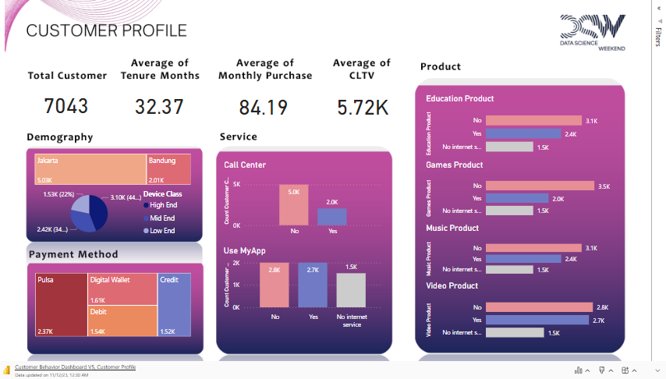
Key Takeaways:
Localized Approach: Targeting strategies for the Jakarta market could enhance engagement.
Tech-Centric Services: Tailoring offerings for high-end device users might elevate satisfaction and engagement.
Streamlined Payment: Improving 'pulsa' payment options could enhance customer experience.
Digital Enhancement: Focus on improving 'Use MyApp' for efficient self-service interactions.
Content Prioritization: Investment in 'Video,' 'Education,' and 'Music' services to meet customer demands and drive engagement.
Insights:
Geographic Concentration: Predominance of customers from Jakarta indicates a localized customer base.
Device Preference: High-end device usage among the majority signifies a tech-savvy or premium user segment.
Payment Method Dominance: 'Pulsa' as the primary payment method highlights a preference for prepaid services or convenient transactions.
Service Utilization: Higher reliance on 'Use MyApp' over 'call center' suggests a preference for self-service or digital interactions.
Popular Products: 'Video', 'Music', and 'Education’ products are top choices, indicating a demand for entertainment, educational, and media-based content.

Slide 11
Churn Deep Dive
ANALYSIS
A comprehensive analysis of churn involves delving deep into customer data. Investigating the reasons behind churn, identifying pivotal factors contributing to customer attrition, and examining the timing and context of churn events provide critical insights for retention strategies.

Slide 12
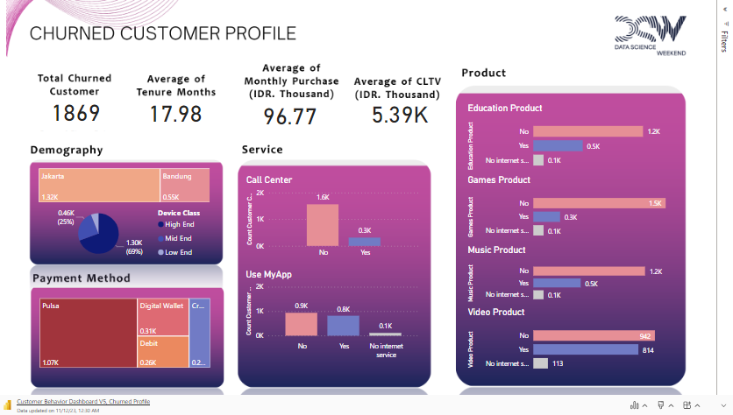
Key Takeaways:
Diverse Service Preferences: Customers favor digital interactions but might find traditional call center services less appealing.
Product Interest and Retention: Despite low usage in some products, the 'Video' product remains popular, offering an opportunity for retention strategies around this content.
Holistic Churn Understanding: A combination of service usage, product engagement, and payment method should be considered for comprehensive churn analysis and tailored retention efforts..
Insights:
Payment Method and Churn: The prevalent use of 'pulsa' among churned customers suggests it might not be the sole driver of churn.
Service Preference and Churn: Higher 'Use MyApp' usage but minimal use of 'call center' among churned customers implies a digital service inclination and possible dissatisfaction with traditional support channels.
Product Engagement and Churn: Although a higher number of churned customers don't use certain products, there's a notable usage of the 'Video' product, indicating potential value and interest in this content.

Slide 13
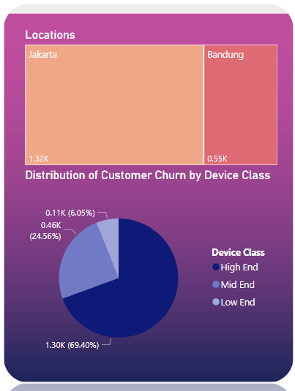
CHURNED CUSTOMER PROFILE
7043 Unique Cust ID
All Unique Cust ID
Churned Customer Demographics
1869 Unique Cust ID (CHURN)
5174 Unique Cust ID (NO CHURN)
858 Unique Cust ID
Has an above-average CLTV value
1011 Unique Cust ID
Has an under-average CLTV value
857 Unique Cust ID
Has an under-average Tenure Months
154 Unique Cust ID
Has an above-average Tenure Months
Insight:
Of the churned customers, 1011 show lower CLTV, potentially impacting long-term profitability. Additionally, 857 had below-average tenure, indicates new joiners and likely affecting loyalty, while 607, despite churning, represent a high-value segment with above-average monthly purchases.
Most of the churn customers come from Jakarta as many as 1323 customers and use high end device class.
250 Unique Cust ID
Has an under-average Monthly Purchases
607 Unique Cust ID
Has an above-average Monthly Purchases
Notes:The average was calculated using data from all users in the dataset.

Slide 14
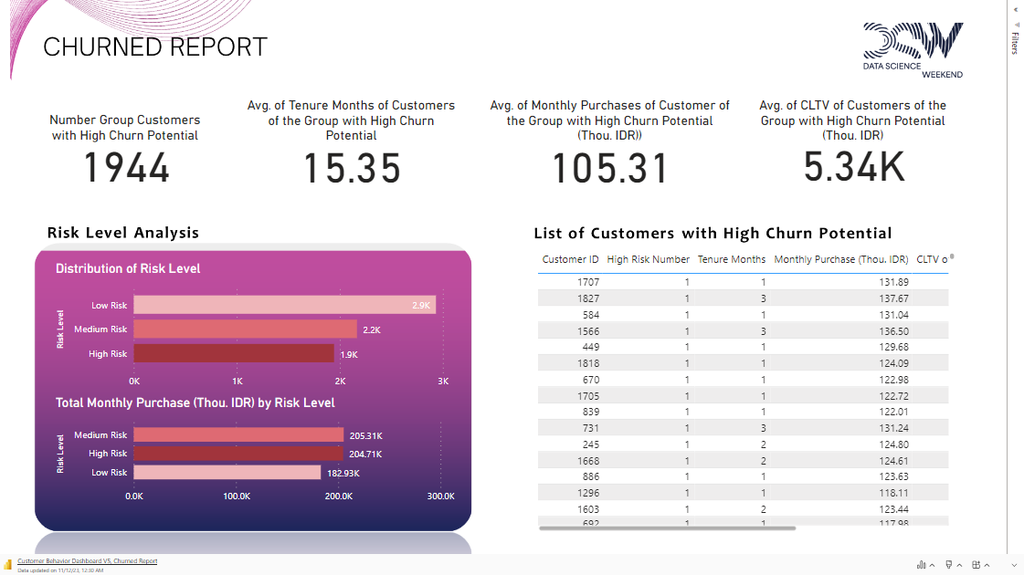

Slide 15
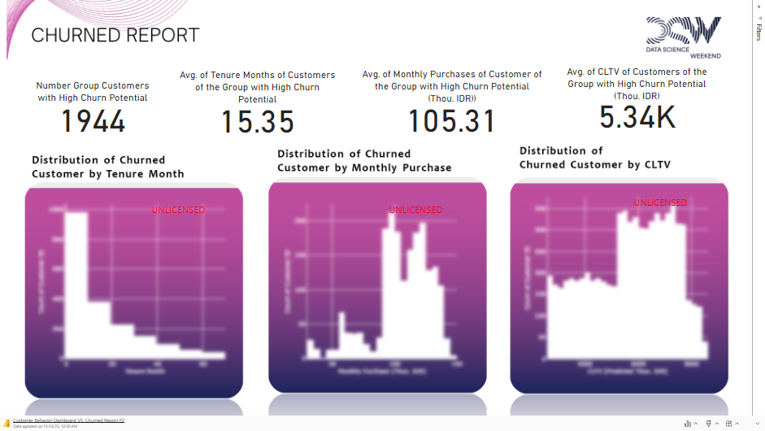
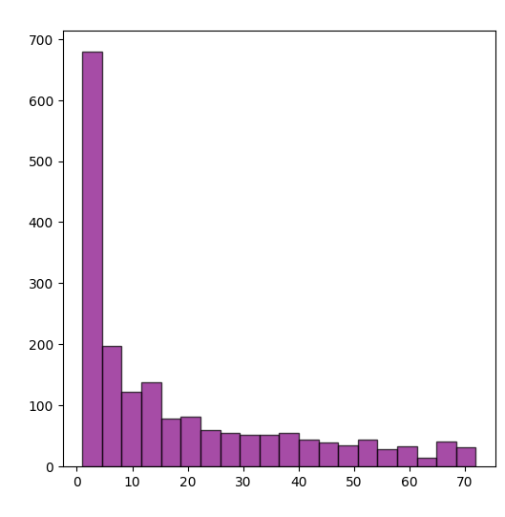
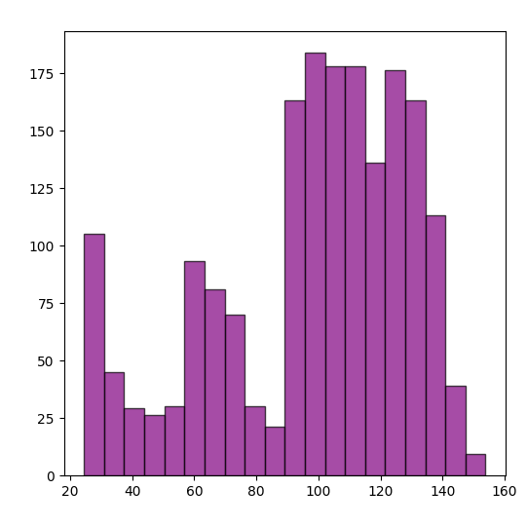
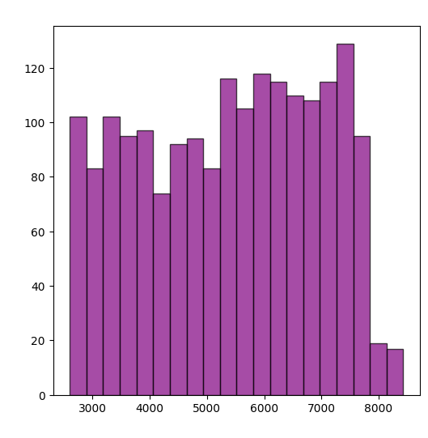
Insights:
New Joiners and Churn: A significant proportion of churned customers are new joiners with tenures under a year, indicating a vulnerability among recently acquired customers.
Monthly Sales and Churn: Despite good monthly sales among churned customers (above average), their retention remains a challenge, hinting at factors beyond sales impacting churn.

Slide 16

EVIDENCE CUSTOMER PROFILING DASHBOARD
Churned Customer Summary Dashboard

Slide 17
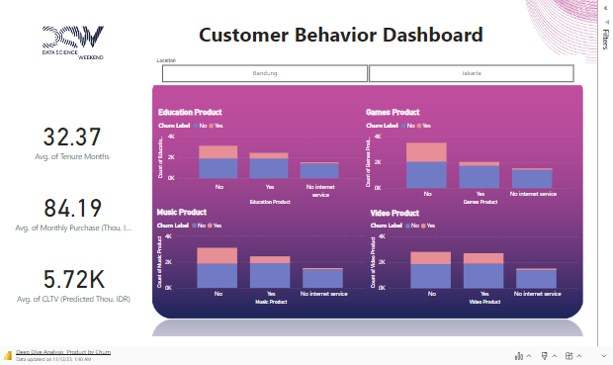
CHURN DEEP DIVE ANALYSIS
PRODUCT
The analysis of product-specific churn rates reveals distinct patterns across various offerings. Notably, users of the Education Product exhibit a relatively lower churn rate at 22.7%, whereas those who do not utilize the product experience a higher churn rate of 39.6%. Similarly, the Games Product demonstrates a lower churn rate of 14.6% among users, while non-users face a higher rate of 41.7%. The Music Product follows a comparable trend, with a churn rate of 21.5% for users and 39.9% for non-users. Interestingly, the Video Product sees a moderate churn rate of 30% among users, slightly lower than the 33.5% rate among non-users. These insights emphasize the potential impact of specific products on user retention, indicating areas for strategic focus and improvement.

Slide 18
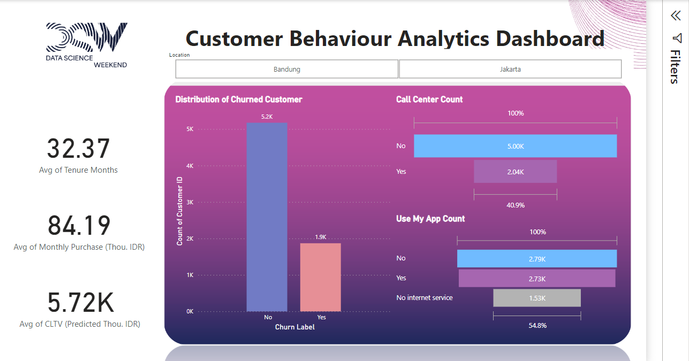
CHURN DEEP DIVE ANALYSIS
SERVICE
The analysis of service-specific churn rates highlights notable distinctions between users who utilize and those who do not utilize particular services. Specifically, for the Call Center service, only 15.1% of users experience churn, contrasting with a higher churn rate of 31.1% among those who do not utilize the Call Center service. Similarly, the Use My App service witnesses a churn rate of 29.9% among users, whereas non-users face a slightly higher churn rate of 33.6%. These findings underscore the impact of service usage on customer retention, suggesting potential areas for strategic enhancement and targeted efforts to improve overall customer satisfaction and loyalty.

Slide 19
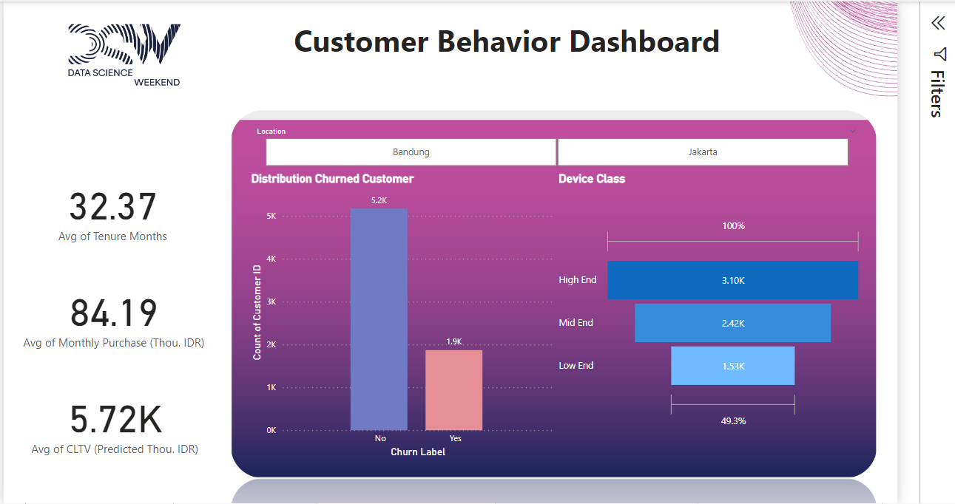
CHURN DEEP DIVE ANALYSIS
DEVICE CLASS
In summary, the analysis of churn rates based on device classes reveals noteworthy discrepancies in customer retention. Among the 3096 users utilizing high-end class devices, a significant 41.8% experience churn, indicating a considerable challenge in retaining this segment of customers. In contrast, the churn rate is comparatively lower at 18.9% among the 2421 users using mid-end class devices. Notably, the low-end class devices exhibit a remarkable retention rate, with only 7.4% of the 1526 users facing churn. These findings underscore the substantial impact of device class on customer churn, suggesting a need for tailored strategies to address the unique preferences and needs of users with high, mid, and low-end devices. Such insights can guide businesses in refining their offerings and services to enhance overall customer satisfaction and retention.

Slide 20
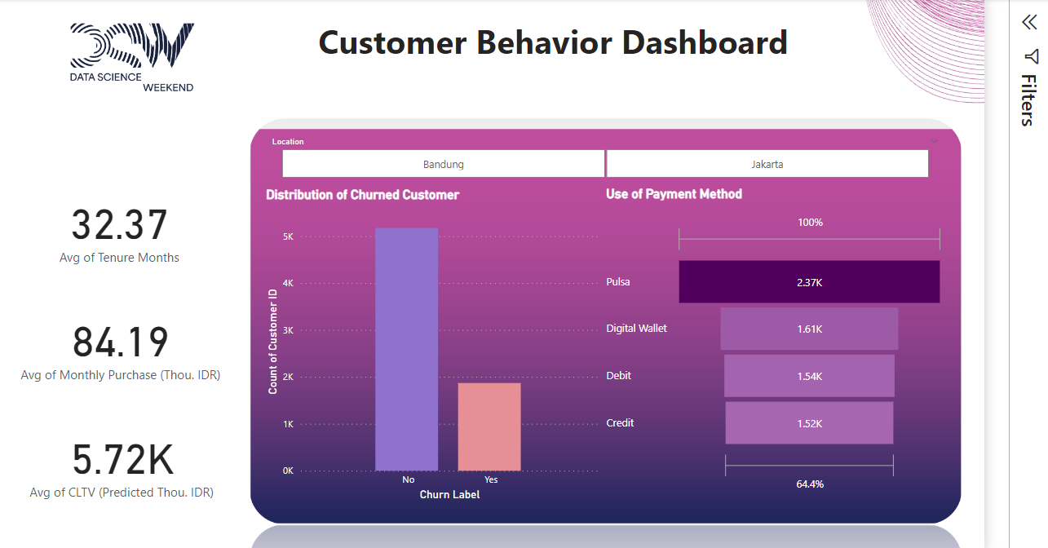
CHURN DEEP DIVE ANALYSIS
PAYMENT METHOD
The examination of churn rates based on different payment methods reveals intriguing patterns in customer behavior. Notably, among the 2365 users utilizing pulsa as their payment method, a substantial 45.3% experience churn, indicating potential challenges or dissatisfaction associated with this payment option. Conversely, customers using digital wallets demonstrate a more favorable churn rate, with 19.1% experiencing churn out of the total 1612 users. Furthermore, users employing debit cards exhibit a churn rate of 16.7%, and those using credit cards experience an even lower churn rate of 15.2% among the total 1522 customers. This analysis suggests that the choice of payment method plays a role in customer retention, with digital wallets showing a comparatively higher retention rate. Businesses may benefit from further investigating the factors contributing to these churn rates and strategizing accordingly to enhance overall customer satisfaction and loyalty.

Slide 21
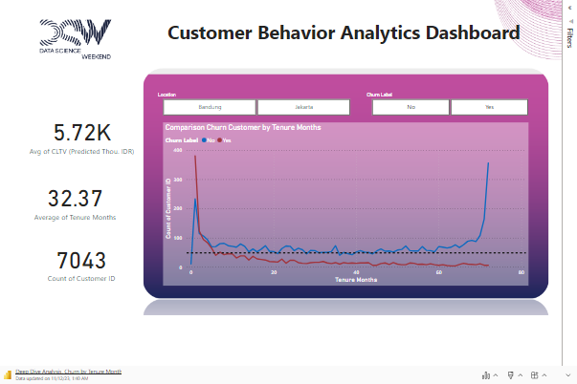
CHURN DEEP DIVE ANALYSIS
TENURE MONTHS
The examination of churn-related factors reveals crucial insights. Users who churn have an average tenure of 18 months, significantly less than the 37.5 months observed for non-churning users. The positive correlation between a 69-month tenure and reduced churn highlights the importance of fostering long-term relationships. Challenges arise in the initial month, marked by a surge in new customers and high churn. Additionally, efforts to retain customers during the initial five months could be strengthened. Understanding these patterns is pivotal for strategic customer retention, emphasizing the need for a balanced approach to early engagement and sustained, quality service over time.

Slide 22
EVIDENCE CHURN DEEP DIVE ANALYSIS DASHBOARD
Customer Churn Detail Dashboard

Slide 23
Churn Prediction
APP DEVELOPMENT
Developing a predictive application capable of foreseeing potential churn is essential. Leveraging machine learning models and historical customer data, the app aims to forecast churn, empowering telecom companies to take proactive measures to retain customers before they consider switching to other providers.

Slide 24
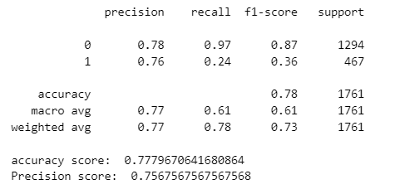
Model Performance
Churn Prediction
App Development
The churn prediction app uses machine learning and historical customer data to forecast potential churn. By analyzing customer behavior, it identifies high-risk customers, allowing businesses to implement proactive strategies for retention, thereby maintaining valuable relationships.
Classification report [images by author]
Choosing precision over recall in our churn model, conducted with Logistic Regression, resulting in an accuracy and precision of around 75% after fine-tuning and multiple feature engineering iterations, aligns with our business objectives. We prioritize precision to ensure that the identified churn cases are highly accurate, allowing for targeted resource allocation in retention efforts. This focus on precision optimizes our retention strategies, enabling cost-effective and efficient allocation of resources.
However, while our model, utilizing logistic regression, has shown significant success, there remains ample room for further enhancement in accuracy and precision, ensuring ongoing improvements to refine our customer retention initiatives."

Slide 25

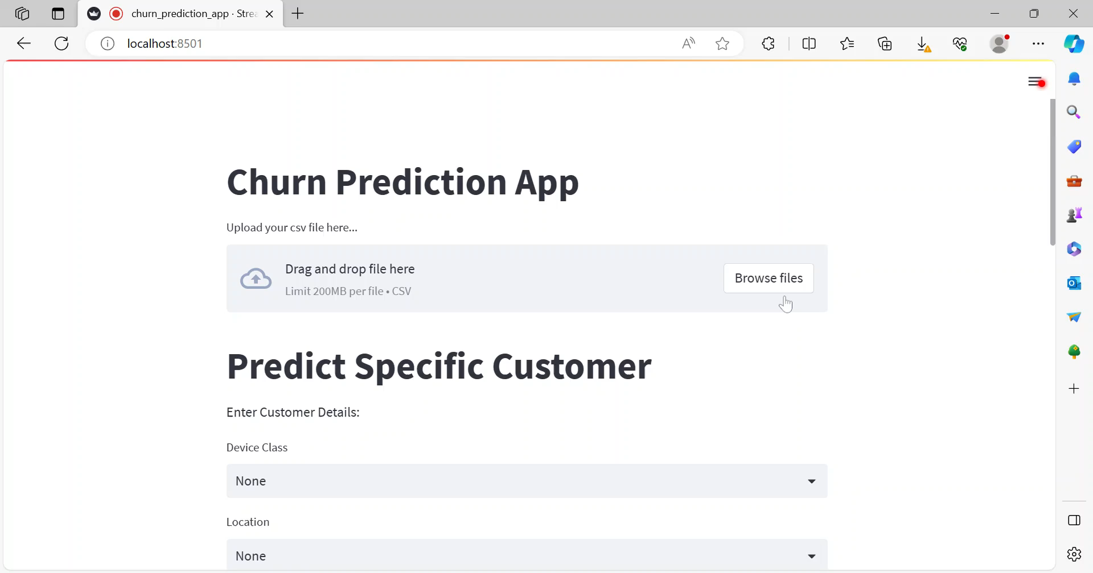
Link to video

Slide 26
CONCLUSION
Customer
Churn Deep Dive
Churn Prediction App
PROFILING
ANALYSIS
DEVELOPMENT
Key Customer Preferences Identified:
'Pulsa' payment prevalence suggests payment method isn't the sole driver of churn.
'Use MyApp' preference over 'call center' indicates a desire for self-service and digital interaction.
Top engagement with 'Video,' 'Education,' and 'Music' products signifies significant customer interest.
26% of the total customers have churned.
Vulnerability of New Customers: The high proportion of churn among new joiners, especially those with tenures under a year, underscores the vulnerability of recently acquired customers, demanding targeted retention efforts for this segment.
Nuanced Churn Factors: While high-value segments with above-average monthly purchases contribute to churn, the complexity goes beyond sales metrics, emphasizing the need for a holistic analysis to comprehend and address diverse churn drivers.
Geographic and Device Influence: The concentration of churned customers from Jakarta, using high-end devices, suggests regional and technological factors might play a role in churn behavior, warranting region-specific and technology-aligned retention strategies.
Proactive Churn Forecasting:
Uses machine learning and historical data to identify high-risk customers.
Enables businesses to implement targeted retention strategies.
Precision Resource Allocation:
Logistic Regression model prioritizes precision for accurate churn identification.
Allows focused resource allocation in retention efforts.
Continuous Improvement for Retention:
Ongoing enhancements in accuracy and precision for refining customer retention strategies.

